Slide 1
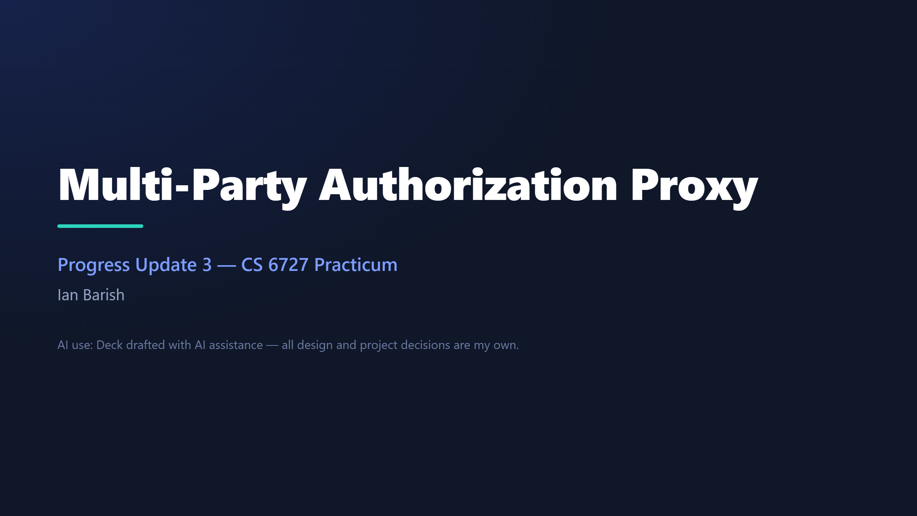
Notes:
SCRIPT (~10s): • "Hi — this is my third progress update on the multi-party authorization proxy." • "Last cycle I finished the written design; this cycle I actually built it." Then move straight on.

Slide 2
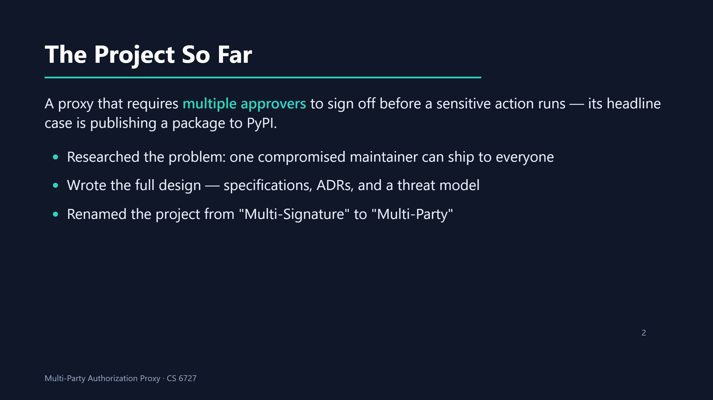
Notes:
SCRIPT (~30s, HARD CAP): • "Quick recap for anyone who missed a video: this is a proxy that requires multiple people to approve a sensitive action before it runs, and the headline case is publishing a package to PyPI." • "The first cycle was research — I showed how one compromised maintainer can ship to everyone." • "The second was the full written design: the specifications, the ADRs, and a threat model. I also renamed it from Multi-Signature to Multi-Party." • Don't retell the story — just set the baseline so this cycle lands.

Slide 3
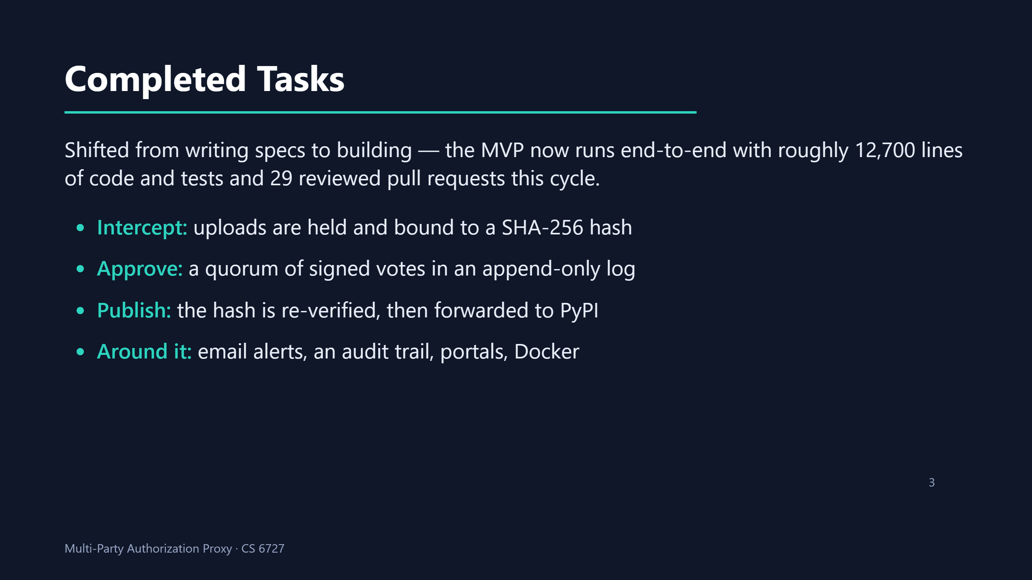
Notes:
SCRIPT (~90s): • "This cycle I shifted from writing specs to building — the MVP now runs end-to-end, and it comes to about 12,700 lines of code and tests across 29 reviewed pull requests this cycle." • "The flow is three steps. First, intercept: a developer uploads with their normal tooling, the proxy catches the upload, holds the file, and fingerprints it with a SHA-256 hash." • "Second, approve: the configured approvers each cast a signed yes-or-no vote, and every vote is appended to a log that nobody can edit after the fact — and it waits until a quorum agrees." • "Third, publish: right before sending, the proxy re-verifies that fingerprint so the file can't have been swapped underneath it, and only then forwards it on to PyPI." • "Around all of that is the supporting machinery — email alerts, an audit trail, the approver and admin portals, and Docker packaging." • "And to show the design is general and not PyPI-specific, the same approval engine already drives a second use case — granting temporary web access."

Slide 4
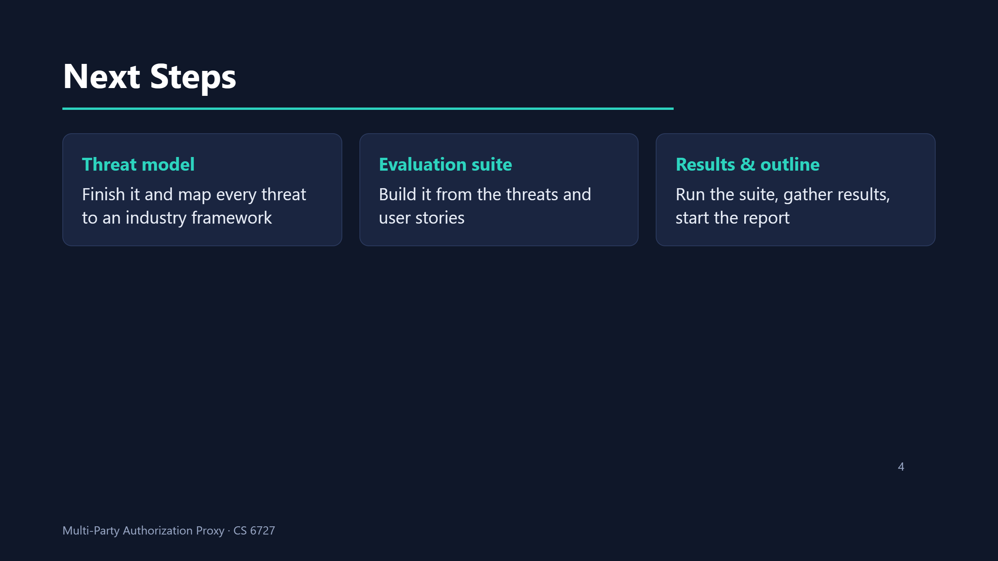
Notes:
SCRIPT (~60s): • "Next steps, in order. The security results hinge on the threat model, so that comes first — I'll finish enumerating the threats and map each one to a public industry framework." • "Then I build the evaluation suite out of those threats and the user stories: each threat becomes something I can check — a passing test, an argued design property, an operator setting, or an accepted limitation — and I'll reuse the tests I've already written rather than start over." • "Finally I run the suite, gather the numbers, and start outlining the final report. The order matters: I can't score the system before I know what I'm scoring it against."

Slide 5
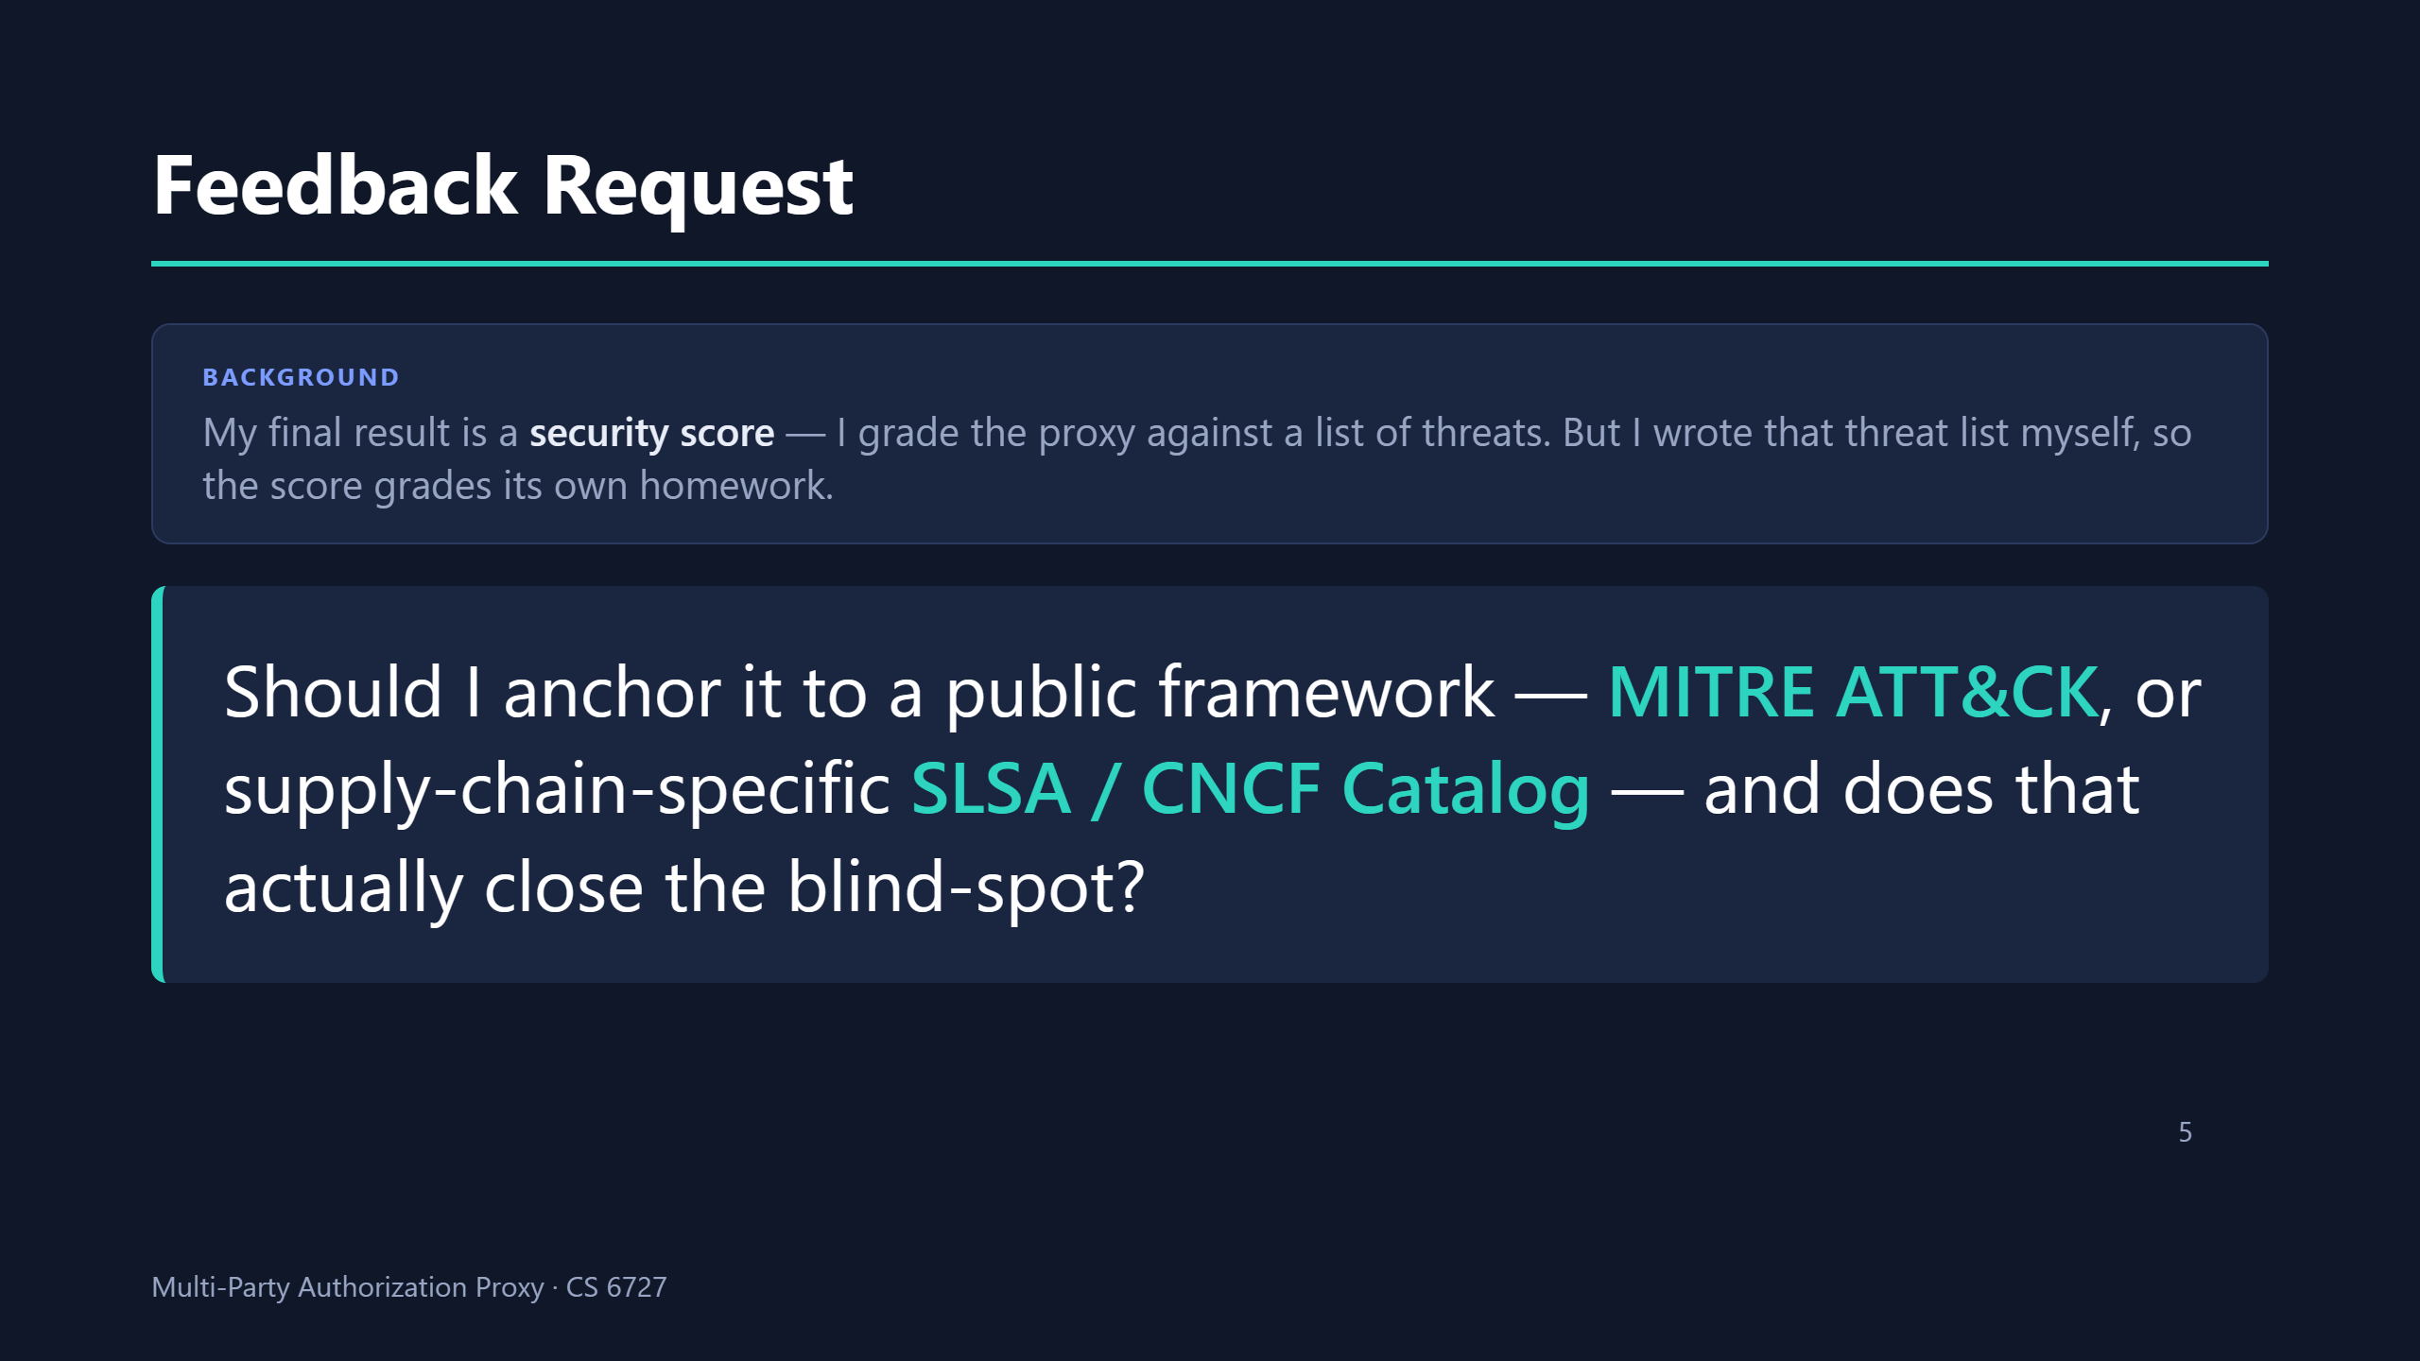
Notes:
SCRIPT (~40s): the video ENDS here — protected slot, do not rush. • "Last thing — a question for the group. My final deliverable is a security score: I grade the proxy against a list of threats, and the score is really just how many threats fall into each bucket." • "The problem is I wrote that threat list myself, with AI, so the score is grading its own homework — if I missed a threat, I also miss it in the grade." • "To avoid that blind spot I want to anchor the list to a public taxonomy. MITRE ATT&CK is broad and I already know it; SLSA and the CNCF catalog are narrower but supply-chain-specific." • "So: which should I anchor to, and does grounding it in a public framework actually close the self-grading blind spot?"

